Slide 1
Cambridge TECHNICALS LEVEL 3
2016
2.4 - Understand the legal and regulatory framework governing the storage and use of global information

Slide 2
RELATED ACTIVITIES
e
This unit | Title of suggested activity | Other units/LOs
LO4 | UK and global accessibility legislation relating to the storage and use of information | Unit 10 Business Computing | LO4 Be able to present data analysis outcomes
 | UK legislation and regulation relating to the storage and use of information | Unit 2 Global information | LO3 Understand the use of global information and the benefits to individuals and organisations LO4 Understand the legal and regulatory framework governing the storage and use of global information

Slide 3
RELATED ACTIVITIES
e
Explanations of the key terms used within this unit, in the context of this unit
Data | Data is information that has been coded and structured in some way, ready for processing, storage, transmission, etc. Data has no context and has no meaning. Examples of data could include: shoe size stored in the stock database of a shop, a date, etc.
Global divide | The divide that exists in terms of access to information between different countries and different types of holders of information across the world.
Green IT | The practice of reducing energy use by IT equipment and thus improving sustainability. This relates to both individuals and organisations. The main purpose of Green IT is to increase the sustainability of IT equipment and operations. Examples of Green IT range from an individual using their PC power settings to automatically switch off the screen after a certain time with no keyboard/mouse activity, up to the virtualisation of a large, global organisation’s data stores to reduce the number of servers in their data centres.
Holder of information | Any individual or organisation that holds information
Information | Information is data that has been given context and meaning in some way (e.g. by processing, storing or transmission). An example of information is: a shop receipt showing the model, price and size of shoes, together with the time and date of the purchase
Information formats | The different ways in which information can be presented using world wide web (www) technologies. Examples of information formats are: web pages; RSS feeds; podcasts; blogs; and social media channels.
Information style | The style of information, regardless of the technology used. For example, the audio information style could be represented by spoken instructions, an MP3 music file, a DVD soundtrack or a podcast. Many, but not all, of the information styles will have a corresponding information format on the world wide web.

Slide 4
Assignment Scenario
There are 5 sections to this Theory Unit, each of which will give you a basic understanding and practice at possible exam questions. It will involve gaining knowledge towards the answers.
This is not a wrote learning course, you will need to understand the basics of ICT in order to adapt your knowledge towards companies and their needs. For LO4, this will involve understanding:
UK legislation and regulation relating to the storage and use of information
Categories of information used by individuals that hold information
Consolidation
UK and global accessibility legislation relating to the storage and use of information
Global information protection legislation and regulation
Green IT
In the exam you will be given precise questions requiring precise answers based on a scenario to answers questions from, and adapt your knowledge and use the key terms and named components to give a judgemental answer.

Slide 5
4.1 - UK legislation and regulation relating to the storage and use of information
All companies have procedures they apply to staff and rules they apply to themselves in the common working day. The importance of these vary between companies, for instance a Builders Yard is more likely to abide by the Health and Safety at Work Act because of the risk of dangers whereas an office is more like to be guided by the DPA and CMA. But there are additional risks to Data protection in offices that are not as apparent to those of building sites:
Data Protection Act (1998) - allows a person the right to know what information an organisation holds on them and the right to correct information that is wrong
Computer Misuse Act - enacted to respond to the growing threat of hacking to computer systems and data
Copyright Legislation - gives the creators of some types of media rights to control how they are used and distributed - refers to music, books, video and software
Contracts of Employment - the behaviours they would need to apply when employed in any workplace.
Regulation of Investigatory Powers Act -
Protection of Freedoms Act 2012 – Covers the rights of individuals in the safe storage, use and display of their information.
The 2002 E-commerce Regulations – Dictates what kind of information is stored and used by companies online services
The 10 stipulations of the DPA Why does the Law keep having to be updated What is Ethical Hacking Is leaving bad feedback in a review illegal. Is Video Streaming a breach of Copyright Can you really see all the information on school system about you

Slide 6
4.1 - UK legislation and regulation – Data protection Act
Data Protection Act 1988 - This Act applies to personal information about an individual
The Act defines a legal basis for handling in the United Kingdom of information relating to people living. It is the main/only piece of legislation that governs protection of personal data in the UK. Although the Act does not mention privacy, in practice it provides a way in which individuals can enforce the control of information about themselves. Most of the Act does not apply to domestic use, for example keeping a personal address book. Businesses operating in the UK are legally obliged to comply with this Act, subject to some exemptions.
Compliance with the Act is enforced by an independent authority, the Information Commissioner's Office (ICO). The ICO maintains guidance relating to the Act
It is aimed at protecting the rights of the individual to privacy. The Act is quite complex but there are basically eight common sense rules - known as the ‘data protection principles’
Gives important rights to the person about whom the data is held about. This includes the right to know what information is held, including information held by an employer, and the right to correct information that is wrong
Compensation can be claimed through the courts if an organisation breaches this Act and causes damage, such as financial loss, claim for distress caused as a result of the incident
If an organisation holds any data on individuals, it must register under the Act.
Employees must adhere to the Act and the employer will have rules/ guidelines to follow
The employer will be prosecuted if they break this law and if an employee is found to be negligent, he/she may be liable for prosecution too.

Slide 7
4.1 - UK legislation and regulation – Data protection Act
The Act defines eight principles of information-handling practice:
Personal data shall be processed fairly and lawfully and, in particular, shall not be processed unless conditions are met.
Personal data shall be obtained only for one or more specified and lawful purposes, and shall not be further processed in any manner incompatible with that purpose or those purposes
Personal data shall be adequate, relevant and not excessive in relation to the purpose or purposes for which they are processed
Personal data shall be accurate and, where necessary, kept up to date
Personal data processed for any purpose or purposes shall not be kept for longer than is necessary for that purpose or those purposes
Personal data shall be processed in accordance with the rights of data subjects under this Act
Appropriate technical and organisational measures shall be taken against unauthorised or unlawful processing of personal data and against accidental loss or destruction of, or damage to, personal data
Personal data shall not be transferred to a country or territory outside the European Economic Area unless that country or territory ensures an adequate level of protection for the rights and freedoms of data subjects in relation to the processing of personal data.
Basically this means that data must be:
fairly and lawfully processed (used)
used for limited purposes
adequate and relevant - only what is needed may be used
accurate
not kept for longer than is necessary
accessible to the individual and able to be corrected or removed where necessary
secure
not transferred to countries without adequate protection.
Task 01 - Produce a report describing what each of the stipulations means in school terms, the risks to information it protects and the measures a school needs to consider when dealing within data held

Slide 8
4.1 - UK legislation and regulation – Copyright and Designs Patent Act
Just buying a book, CD, video or computer program does not give you the right to make copies (even for private use) or play or show them in public. The right to do these things generally belongs to the copyright owner, so you will need their permission to use their material.
Copyrighted images versus copyright free images – They say free stuff is worth every penny you pay for it. The internet is full of images, every picture you could want, who would notice if you took it. Copyright is the second most important and quoted law in ICT, the one that is breached the most and one that is considered thin in terms of prosecution and effect.
What is protected by copyright? - Copyright protects original literary, dramatic, musical and artistic works, published editions of works, sound recordings (including CDs), films (including videos and DVDs) and broadcasts. The creator of the material has the right to control the way their work can be used. Their rights cover such things as:
So copyright is a type of ‘intellectual property’ and, like physical property, cannot usually be used without the owner’s permission.
Task 02 – Describe in terms of a school, the intention of the Copyright Act and describe the risks and the measures you need to take to prevent illegal use of resources.
For example, Performing in Public and playing videos for students in the last days.
Copying | Adapting | Distributing | Communicating through Electronic means to the Public | Renting or Lending Copies to the Public | Performing in Public

Slide 9
4.1 - UK legislation and regulation – Copyright and Designs Patent Act
What about computer programs and material stored in computers? - A computer program is protected as a literary work.
Converting a program into or between computer languages and codes counts as ‘adapting’ a work
Storing any work in a computer involves ‘copying’ the work
Running a computer program or displaying work on a VDU will usually involve ‘copying’
Is material on the internet protected by copyright? - Copyright material sent over the internet or stored on web servers will usually be protected in the same way as material recorded on other media.
So if you want to put copyright material on the internet to distribute or download copyright material that others have put on the internet, you will need to make sure that you have permission from the people who own the rights in the material
Does copyright have to be registered? - Copyright protection in the UK is automatic, No registration system is necessary, i.e. no forms to complete and no fees to pay.
Does work have to be marked to claim copyright? - In some countries you must mark the work with the international © mark followed by the creator’s name and the year of creation. (Additional information could be included such as how far you are happy for others to use your copyright material without permission)
Not necessary in the UK, but helps if action is taken when copyrighted materials is used without required permission.

Slide 10
4.1 - UK legislation and regulation – Computer Misuse Act
The Computer Misuse Act – This Act is designed to protect computer users against wilful attacks and theft of information. Offences under the act include hacking, unauthorised access to computer systems and purposefully spreading malicious and damaging software (malware), such as viruses.
Unauthorised access to modify computers include altering software and data, changing passwords and settings to prevent others accessing the system, interfering with the normal operation of the system to its detriment.
The act makes it an offence to access or even attempt to access a computer system without the appropriate authorisation. Therefore, even if a hacker tries to get into a system but is unsuccessful they can be prosecuted using this law. The act also outlaws "hacking" software, such as packet sniffers, that can be used to break into or discover ways to get into systems.
What the Law States – Part 1:
1 - Unauthorised access to computer material.
(1) A person is guilty of an offence if—
(a) he causes a computer to perform any function with intent to secure access to any program or data held in any computer, or to enable any such access to be secured;
(b) the access he intends to secure, or to enable to be secured, is unauthorised; and
(c) he knows at the time when he causes the computer to perform the function that that is the case.
(2) The intent a person has to have to commit an offence under this section need not be directed at—
(a) any particular program or data;
(b) a program or data of any particular kind; or
(c) a program or data held in any particular computer.

Slide 11
4.1 - UK legislation and regulation – Computer Misuse Act
2 - Unauthorised access with intent to commit or facilitate commission of further offences.
(1) A person is guilty of an offence under this section if he commits an offence under section 1 above (“the unauthorised access offence”) with intent—
(a) to commit an offence to which this section applies; or
(b) to facilitate the commission of such an offence (whether by himself or by any other person);
(2) It is immaterial for the purposes of this section whether the further offence is to be committed on the same occasion as the unauthorised access offence or on any future occasion.
(4) A person may be guilty of an offence under this section even though the facts are such that the commission of the further offence is impossible.
3 Unauthorised acts with intent to impair, or with recklessness as to impairing, operation of computer,
(1) A person is guilty of an offence if—
(a) he does any unauthorised act in relation to a computer;
(b) at the time when he does the act he knows that it is unauthorised; and
(2) This subsection applies if the person intends by doing the act—
(a) to impair the operation of any computer;
(b) to prevent or hinder access to any program or data held in any computer;
(c) to impair the operation of any such program or the reliability of any such data
(3) A person guilty of an offence under this section shall be liable—
(a) on summary conviction in England and Wales, to imprisonment for a term not exceeding 12 months (6 months in Scotland) or to a fine not exceeding the statutory maximum or to both;
(b) on conviction on indictment, to imprisonment for a term not exceeding ten years or to a fine or to both

Slide 12
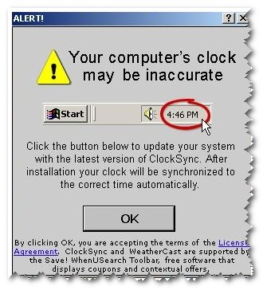
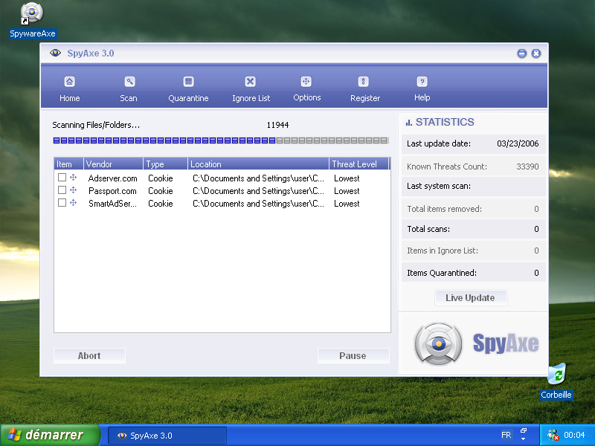
4.1 - UK legislation and regulation – Computer Misuse Act
Spyware: Spyware is computer software that is installed secretively on personal computers that either intercept or take partial control over the user's interaction with the computer, without the user's informed consent. The term spyware suggests software that secretly monitors the user's behaviour; the functions of spyware extend well beyond simple monitoring.
This is an example of spyware program that installs itself onto the machine or tries to. The box that pops up on the screen tells the user that their clock is not up to date an option of installing it or cancelling but both are fake, the whole image including the buttons is all part of the spyware. When installed this particular piece of spyware which pretends to be a windows program then leaves a tracer on the machine that gathers information about the user and then uses this information for spying, gathering such things as credit card details, log in names and passwords and account information.
Spyware has a general negative effect on the internet and has the overall ability to steal personal and important information off of the computer user. Pornography websites as a whole have a tendency to be unsafe and lacking in protection due to their overall professionalism lacking. This means that they are quite popular for spyware content and hacking.
Malware: Malware is software specifically designed to infiltrate or damage a computer system without the owner's consent. The term is an amalgamation of the words malicious and software. The expression is a general term used by computer professionals to mean differing forms of hostile, intrusive, or annoying software or program code.
Spyaxe is an example of a particularly nasty version of malware that installs itself onto the user’s computer and then runs and tells the user that they have spyware on their machine. The scan itself is fake but the user won’t be able to see this. It then says that there is particularly spyware on the machine and in order to be able to fix it the user needs to upgrade to the full version of spyaxe. The user feeling that they have already been hacked goes onto the spyaxe website and pays for the full version. The company then uses their credit card details to steal everything they can. If the user tries to remove this program off the machine then spyaxe claims a breach in copyright and threatens to sue.

Slide 13
4.1 - UK legislation and regulation – Computer Misuse Act
Viruses - A computer virus is something that will copy and attach itself to a computer’s code. A virus can only spread from one computer to another when its host is taken to the uninfected computer, for instance by a user sending it over a network or the Internet. Viruses are sometimes confused with computer worms and Trojan horses. A worm can spread itself to other computers without needing to be transferred as part of a host, and a Trojan horse is a file that appears harmless. Worms and Trojans may cause harm to either a computer system's hosted data, functional performance, or networking throughput, when executed. In general, a worm does not actually harm either the system's hardware or software.
The “Iloveyou” virus was created by a Philipino teenager to impress his girlfriend. An email was sent out with a VBS attachment saying “Iloveyou”. When the user opened up the VBS file the email raided the outlook express book and sent itself on to everybody in their using their username. Within one hour of the virus being released 20,000 computers were infected, within three hours this had risen to 5 million. All together this cost one billion pounds worth of damage worldwide causing a complete destruction of networks and the shutting down of several major systems.
The “lovesan” virus was created by a German teenager in order to help out his mums failing computer business. Like the “Iloveyou” virus this was an attachment within an email that within three hours had managed to bring down the NHS network centre, the French water system and the entire Swiss rail network. All together this virus cost untold amount of damage across the world.
Worms - These are in some ways a lot like a computer virus in the way that they tend to replicate themselves and sends copies of itself through the use of a network this usually goes on with little to no intervention from the user. When worms are put into action it is highly likely that it will cause some damage to a network or computers often the best case scenario is for it just to take up some of the bandwidth. Sometimes however a worm can be created with the best intentions but easily cause some unintended disruption.
Trojans – These are files that actually get emailed to you that have the virus hidden within the code. This is much more difficult to pick up because virus checkers tend to look within specific strings of code but a good Trojan can break itself up into little sections so the strings are not recognised. And then when the activation date is due it tends to put itself back together again and breaks itself out of the file. These are a lot harder to detect but once released from the file they will do the same kind of damage that all other viruses will do. They are called Trojans because it is way of getting onto your machine.

Slide 14
4.1 - UK legislation and regulation – Computer Misuse Act
Hacking has been around almost as long as the Internet; some people just love to try and break into a computer system. Prior to 1990, there was no legislation in place to tackle the problems caused by hacking. Although everyone knew that it was wrong and should be against the law, there was nothing that anyone could do about it.
As the problem grew, it became apparent that specific legislation was needed to enable hackers to be prosecuted under the law. So, in 1990, the Computer Misuse Act was passed.
The Computer Misuse Act (1990) recognised the following new offences:
Unauthorised access to computer material
Unauthorised access with intent to commit or facilitate a crime
Unauthorised modification of computer material.
Making, supplying or obtaining anything which can be used in computer misuse offences.
The originally definition of a hacker was a talented computer programmer that could solve almost any problem very quickly, often by innovative, unconventional means. Today it is sometimes used to mean someone that tries to break into other people's computers or creates a computer virus, which isn't quite as noble a concept. The last of the true hackers, Richard Matthew Stallman was born in New York City in 1953. He joined the group of hackers at the MIT Artificial Intelligence Laboratory (AI Lab) in 1971. In 1996 he quoted "The hacker ethic refers to the feelings of right and wrong, to the ethical ideas this community of people had -- that knowledge should be shared with other people who can benefit from it, and that important resources should be utilized rather than wasted."
Today, mainstream usage mostly refers to computer criminals, due to the mass media usage of the word since the 1980s. This includes script kiddies, people breaking into computers using programs written by others, with very little knowledge about the way they work. This usage has become so predominant that a large segment of the general public is unaware that different meanings exist. While the use of the word by hobbyist hackers is acknowledged by all three kinds of hackers, and the computer security hackers accept all uses of the word, free software hackers consider the computer intrusion related usage incorrect, and try to disassociate the two by referring to security breakers as "crackers" (analogous to a safecracker).
Task 03 – Describe with up to date examples the intention of the Computer Misuse Act, and describe the risks and the measures you need to take to prevent illegal use or access to resources.

Slide 15
4.1 - UK legislation and regulation – Computer Misuse Act
Contracts of Employment – When a company needs new staff, more staff or change the levels of a current member of staff, Human Resources, with the consent of management, draw up a Contract of Employment that states legally the terms and conditions of employment for that member of staff. This is a legal document, and states the roles and duties the staff member will be held to.
At the date of hiring that employee will have the right to negotiate the terms of the contract. For instance part of a Teaching contract is Parents Evening attendance, hours of duty, Subject specifics, Pay and a list of other things. Anything added to the contract after acceptance can again be negotiated and refused.
Job Descriptions – Human Resources will draft the job description on behalf of the management and HOD. This will be agreed with all parties before a job advert is placed and is available to the prospective employee or applicant. This Job description outlines the duties of the member of staff, and is usually global in its expectation. Prospective employees read this by prospective employees to see if they are up to the task. For instance a checkout person might be expected to stock shelves as well, the job description will make this clear.
Task 04 – Describe how a Contract of Employment and Job Description can be used to limit the susceptibility of information within a school.

Slide 16
4.1 - UK legislation and regulation – Protection of Freedoms Act 2012
Protection of Freedoms Act 2012 gives a person the right to ask any public body - such as the local authorities and councils, hospitals and doctors’ surgeries, schools, colleges and universities, the police - for all the information they have on a particular subject.
Makes provision in respect of the destruction, retention, and use of fingerprints, footwear impressions and DNA samples.
It covers profiles taken in the course of a criminal investigation. Under the new scheme provided for, the fingerprints and DNA profiles taken from persons arrested for or charged with a minor offence will be destroyed following either acquittal or a decision not to charge.
Extends the existing Freedom of Information Act 2000, extending the scope of the Act and amending the role of the Information Commissioner. This includes widening the rules on applying for and receiving datasets from public authorities for re-use
You can also ask for all the personal information they hold on you - some information might be withheld to protect various interests which are allowed for by the Act / If this is the case, then they must say why they have withheld any information
There is often no fee attached to making a request under the Protection of Freedoms Act unless it is in excess of a certain cost limit. Administration charges, for photocopying and postage for example, may be levied at the discretion of the organisation. If information is requested about themselves, it will be handled under the Data Protection Act.
Task 05 – In terms of a school what does the Protection of Freedoms Act mean in real terms for the storage and display of student information.

Slide 17
4.1 - UK legislation and regulation – Regulation of Investigatory Powers Act
The Regulation of Investigatory Powers Act 2000 (RIPA) regulates the powers of public bodies to carry out surveillance and investigation, and covering the interception of communications. It was mainly introduced to take account of technological change such as the growth of the Internet and strong encryption.
RIPA regulates the manner in which certain public bodies may conduct surveillance and access a person's electronic communications. The Act:
enables certain public bodies to demand that an ISP provide access to a customer's communications in secret;
enables mass surveillance of communications in transit;
enables certain public bodies to demand ISPs fit equipment to facilitate surveillance;
enables certain public bodies to demand that someone hand over keys to protected information;
allows certain public bodies to monitor people's Internet activities;
prevents the existence of interception warrants and any data collected with them from being revealed in court.
In general terms of information this allows certain bodies to share with the government.

Slide 18
4.1 - UK legislation and regulation – Regulation of Investigatory Powers Act
Type | Typical use | Reasons for use | Level of authorisation required
Interception of communication | Wire taps and reading post | In the interests of national security, for the purpose of preventing or detecting serious crime and for safeguarding the economic well-being of the UK | Warrant from Home Secretary or Cabinet Secretary for Justice
Use of communications data | Information about a communication, but not the content of that communication (phone numbers, subscriber details) | See above and in the interests of public safety, for the purpose of protecting public health, for the purpose of assessing or collecting any tax, duty, levy or other imposition, contribution or charge payable to a government department and for the purpose of preventing death or injury or any damage to a person’s physical or mental health. | Senior member of that authority
Directed surveillance | Following people | See above | Senior member of that authority
Covert human intelligence sources | Informers; undercover officers | See above | Senior member of that authority
Intrusive surveillance | Bugging houses/vehicles | In the interests of national security, for the purpose of preventing or detecting serious crime and in the interests of the economic well-being of the United Kingdom. | Authorisation from Home Secretary or Cabinet Secretary for Justice
 |  |  | Or head of the relevant agency: chief constable, the Ministry of Defence Police or the British Transport Police, the Provosts Marshal of the Royal Navy Regulating Branch, Royal Military Police or the Royal Air Force Police and any designated customs officer.

Slide 19
4.1 - UK legislation and regulation – E-commerce Regulations
The 2002 E-commerce Regulations apply to businesses that:
sell goods or services to businesses or consumers on the internet, or by email or Short Message Service (SMS), ie text messages
advertise on the internet, or by email or SMS
convey or store electronic content for customers, or provide access to a communications network
They do not cover direct marketing by phone or fax.
The regulations specify information you must give to customers when you sell online. See provide consumers with contract information.
The regulations also provide guidelines on advertising and promotions. "Commercial communications" must:
be clearly recognisable as such
say on whose behalf they are sent
clearly identify promotional offers and any qualifying conditions
The regulations also cover "unsolicited commercial communications", commonly referred to as spam.
Task 06 – In terms of a nline companies, describe the danger, the law and the difficulty involved in protecting customer information.
Task 07 – Research, present and discuss one of the following in terms of the law and how they are still allowed to happen: Facebook Privacy, Spam, Ethical Hacking, , Twitter abuse, any other ICT privacy issue.

Slide 20
4.1 - UK legislation and regulation – Regulation Impact
Task 08 – For each of the Acts stated, DPA, CMA, FIA or Copyright Act, describe the impact of legislation and regulation on holders of information.
For this you will need to research the ways in which holders of information adapt the way they work, in order to comply with the legislation and regulation. Create a presentation to share this information with the larger group. Information can be gained from:
Information Commissioner’s Office website for organisations: https://ico.org.uk/for-organisations/
Information Commissioner’s Office website for the public: https://ico.org.uk/for-the-public/
Task 09 – Within this presentation describe the consequences of legislation and regulation for holders of information
To do this you will need to research news articles on cases where a holder of information has not complied with the UK legislation and regulation. Describe the problem, the outcome and how it affected or could affect the holder, information and customer. Information can be gained from news articles here or news videos here.

Slide 21
4.2 - Consolidation
Task 10 - Produce a legal guide (clearly focused on the use and storage of information) for new staff in a large UK-based organisation of the different legislation and regulation relating to them.
For this you will need to outline the following in their legal guide:
Data Protection Act (DPA) 1998;
Regulation of Investigatory Powers Act (RIPA) 2000;
Protection of Freedoms Act 2012; Privacy and Electronic Communications
Regulations 2003 (amended 2011);
Freedom of Information Act 2000;
Computer Misuse Act 1990;
Information Commissioner’s Office (ICO) codes of practice;
Copyright, Designs and Patents Act 1988.
Then describe the impact and consequences of legislation and regulation on holders of information by include ‘impact’ and ‘consequences’ sections. In these new sections, provide advice for new members of staff on what they need to do (impacts) and also what could happen if they do not comply with the legislation and regulation (consequences).

Slide 22
4.3 - UK and Global Accessibility Legislation
“Include steps for ensuring that in the circumstances concerned the information is provided in an accessible format”.
Task 11 – Break this quote down so that it is more accessible.
UK Equality Act 2010
The primary purpose of the Act is to simplify the complicated and numerous array of Acts and Regulations, which formed the basis of anti-discrimination law in Great Britain. This was, primarily:
the Equal Pay Act 1970,
the Sex Discrimination Act 1975,
the Race Relations Act 1976,
the Disability Discrimination Act 1995
and three major statutory instruments protecting discrimination in employment on grounds of religion or belief, sexual orientation and age. It requires equal treatment in access to employment as well as private and public services, regardless of the protected characteristics of age, disability, gender reassignment, marriage and civil partnership, race, religion or belief, sex, and sexual orientation.
In the case of gender, there are special protections for pregnant women.
The Act does not guarantee transsexuals' access to gender-specific services where restrictions are "a proportionate means of achieving a legitimate aim".
In the case of disability, employers and service providers are under a duty to make reasonable adjustments to their workplaces to overcome barriers experienced by disabled people.

Slide 23
4.3 - UK and Global Accessibility Legislation - EPA
Equal Pay Act
The Equal Pay Act 1970 which prohibits any less favourable treatment between men and women in terms of pay and conditions of employment.
Elements of a claim
For an employee to claim under this Act they must prove one of the following:
That the work done by the claimant is the same, or broadly the same, as the other employee.
That the work done by the claimant is of equal value (in terms of effort, skill, decision and similar demands) to that of the other employee.
That the work done by the claimant is rated (by a job evaluation study) the same as that of the other employee.
Once the employee has established that they are employed on 'equal work' with their comparator then they are entitled to 'equal pay' unless the employer proves that the difference in pay is genuinely due to a material factor which is not the difference in gender.
Task 12 – Study the cases below and write an evaluation of the Problem, the case and the solution to each.
Allonby v Accrington and Rossendale College
Barber v Guardian Royal Exchange Assurance Group

Slide 24
4.3 - UK and Global Accessibility Legislation - SDA
The Sex Discrimination Act 1975
This is an Act which protected men and women from discrimination on the grounds of sex or marital status. The Act concerned employment, training, education, harassment, the provision of goods and services, and the disposal of premises.
The Gender Recognition Act 2004 and The Sex Discrimination Act 1975 (Amendment) Regulations 2008 amended parts of this Act to apply to transsexual people. Other amendments were introduced by the Sex Discrimination Act 1986, the Employment Act 1989, the Equality Act 2006, and other legislation such as rulings by the European Court of Justice.
The European Human Rights Commission helps carry out the proceedings of any case and may do the following:
Bring proceedings in respect of certain provisions and seek a court injunction to restrain the repetition of an unlawful act
Commence a claim before an employment tribunal on behalf of an individual.
Give practical guidance and advice to persons who appear to have a complaint under the Acts
Task 13 – Study the cases below and write an evaluation of the Problem, the case and the solution to the holder of the information each.
Sailor at a Hampshire Base
Former Male Nurse

Slide 25
4.3 - UK and Global Accessibility Legislation - RRA
The Race Relations Act
The Race Relations Act 1976 was established to prevent discrimination on the grounds of race.
Items that are covered include discrimination on the grounds of race, colour, nationality, ethnic and national origin in the fields of employment, the provision of goods and services, education and public functions.
The Act also established the Commission for Racial Equality with a view to review the legislation, which was put in place to make sure the Act rules were followed.
The Act incorporates the earlier Race Relations Act 1965 and Race Relations Act 1968 and was later amended by the Race Relations Amendment Act 2000, notably including a statutory duty on public bodies to promote race equality, and to demonstrate that procedures to prevent race discrimination are effective.
In essence the act means that it is illegal for a company to take race into consideration in terms of:
Hiring
Working practices
Promotions
Pay or treatment
Task 14 – Study the cases below and write an evaluation of the Problem, the case and the solution to the holder of the information each.
Jewish School Intake
Sikh School Intake

Slide 26
4.3 - UK and Global Accessibility Legislation - DDA
The Disability Discrimination Act
This is an Act which has now been repealed and replaced by the Equality Act 2010. Formerly, it made it unlawful to discriminate against people in respect of their disabilities in relation to employment, the provision of goods and services, education and transport.
The DDA is a civil rights law. Other countries use constitutional, social rights or criminal law to make similar provisions. The Equality and Human Rights Commission combats discrimination. Equivalent legislation exists in Northern Ireland, which is enforced by the Northern Ireland Equality Commission.
It is still permissible for employers to have reasonable medical criteria for employment, and to expect adequate performance from all employees once any reasonable adjustments have been made.
In addition to imposing obligations on employers, the Act placed duties on service providers and required "reasonable adjustments" to be made when providing access to goods, facilities, services and premises, including:
Since 2 December 1994 – It has been unlawful for service providers to treat disabled people less favourably for a reason related to their disability;
Since 1 October 2002 – Service providers have had to make 'reasonable adjustments' for disabled people, such as providing extra help or making changes to the way they provide their services.
Task 15 – Study the cases below and write an evaluation of the Problem, the case and the solution to the holder of the information each.
Starbucks Dyslexia Case
Scottish Nurse Case

Slide 27
4.3 - UK and Global Accessibility Legislation - DDA
Disabled access to websites under UK law
If your business has a website, it should be accessible to disabled users. There are ethical and commercial justifications for this, but there is also a legal reason: if your website does not meet certain design standards, then you could be sued for discrimination.
To date, few companies have faced such legal action. In two cases, actions were initiated by the Royal National Institute for the Blind (RNIB), and both settled without being heard by a court. The RNIB decided against naming the two companies. It has long been anticipated that a higher-profile test case will be launched against a non-compliant website. Clearly, this is a battle which any business will want to avoid.
There has been one case on the accessibility of electronic services that resulted in an employment tribunal finding of discrimination. That case, decided in October 2006, involved the accessibility of a computer-based
Task 16 – Based on Slides 45-49 of LO1 and Outlaw.com, define the legal and moral implications of the school website and show evidence of how the site has been or could be adapted to provide an ethical solution.

Slide 28
4.3 - UK and Global Accessibility Legislation - UNCRP
United Nations Convention on the Rights of Persons with Disabilities is an international human rights treaty intended to protect the rights and dignity of persons with disabilities.
Parties to the Convention are required to promote, protect, and ensure the full enjoyment of human rights by persons with disabilities and ensure that they enjoy full equality under the law.
The Convention has served as the major catalyst in the global movement from viewing persons with disabilities as objects of charity, medical treatment and social protection towards viewing them as full and equal members of society, with human rights.
Task 17 – In order to comply with the United Nations Convention on the Rights of Persons with Disabilities (UNCRPD), research and find evidence to support this statement: “Under the UNCRPD, access to information, communications and services, including the internet, is a human right.”
To do this you will need to look at the following links:
World Federation of the Deaf – UN Convention on the Rights of Persons with Disabilities:
http://wfdeaf.org/human-rights/crpd/article-9-accessibility
http://wfdeaf.org/human-rights/crpd/article-21-freedom-of-expression-and-opinion-and-access-toinformation

Slide 29
4.4 – Global Information and Protection
To introduce this topic, tutors could explain that many other countries have legislation and regulation relating to information security and data protection that is similar to that in the UK. Tutors could also highlight that, just as there is a global divide in terms of access to information, there is also a global divide in terms of legislation and regulation relating to the storage and use of information.
Learners could develop their knowledge and understanding of global information protection legislation and regulation by researching a range of countries around the world. Learners could record their findings in a table that could be shared with the larger group, so that learners are able to compare and contrast a range of countries.
DLA Piper – Data protection laws of the world: http://dlapiperdataprotection.com/#handbook/worldmap-section

Slide 30
4.4 – Global Information and Protection
All countries of the world have some degree of similarity with the UK legislation on Information protection and Computer Safety. And some have just a few similarities and bigger differences.
For instance Afghanistan, Eritrea, Ethiopia, Iran, Iraq, San Marino, Turkmenistan, Tuvalu, Sudan, Somalia, Seychelles, Sao Tome and Principe, Palau, Nauru, Kiribati have either adopted their own laws or adopted modified versions of the World Intellectual Property Organization (Copyright Act)
The 27-country EU directive, passed in 1995, restricts the use, sharing, storing and collecting of personal data (Data Protection Act)
The number of countries with freedom of information laws or similar administrative regulations stands at 99 (Paraguay claims to be 100) (Freedom of Information Act)
Not every country has an Equal Opportunities Act. Click here.

Slide 31
4.4 – Global Information and Protection
All this information is easy to find on the Internet by searching, unless you live in a country where this is restricted of course.
Just as there is a global divide in terms of access to information, there is also a global divide in terms of legislation and regulation relating to the storage and use of information. Does that make Britain better or worse.
Task 18 – before researching the topic, discuss whether you think the laws concerning data in Britain are right, justified, and better or too draconian compared to other countries. Then research your argument and create a report on your findings.
Choose any non EU country (including Britain)
Task 19 - Record their findings in a table and share with the larger group, so that learners are able to compare and contrast a range of countries.
Some information can be gained from:
DLA Piper – Data protection laws of the world: http://dlapiperdataprotection.com/#handbook/worldmap-section

Slide 32
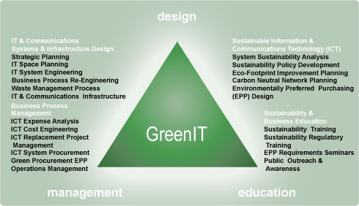
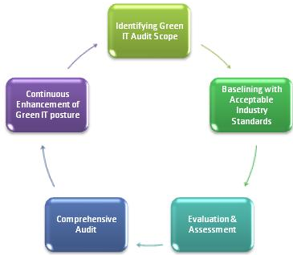
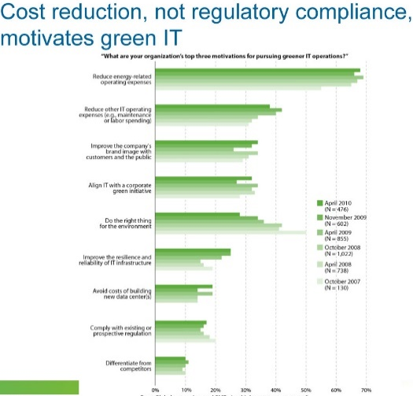
4.5 – Green IT – What it is and Why Care?
What is it
Green IT has emerged as an important topic in information systems and in other areas, such as business sustainability management. Some progress has been made in our understandings of green IT.
Green IT refers to the study and practice of using computers and IT resources in a more efficient and environmentally responsible way. Computers and computing eat up a lot of natural resources, from the raw materials needed to manufacture them, the power used to run them, and the problems of disposing them at end of life.
Why Should You Care?
All businesses are increasingly dependent on technology, and small business is no exception. We work on our PCs, notebooks and smart phones all day, connected to servers running 24/7. Because the technology refresh cycle is fast, these devices quickly become obsolete, and at some point — more often sooner than later — we dispose of old devices and replace them with new ones. We use massive quantities of paper and ink to print documents, many of which we promptly send to the circular file.

Slide 33
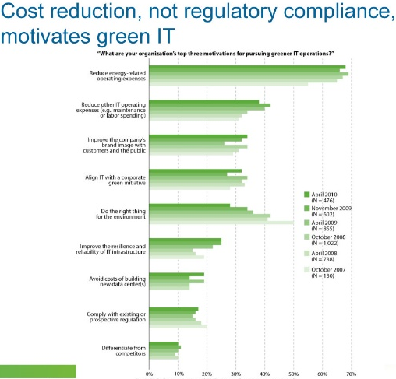
4.5 – Green IT – How to Be Green?
Eliminate paper, printer and packaging waste.
Buy remanufactured toner cartridges and get personal ink cartridges refilled to save money and reduce waste. If you’re looking for a new printer, shop for one that automatically prints double-sided (Duplex).
When shopping for new products, look for eco-friendly packaging.
Reduce power consumption. “Set it and forget” tools, such smart power strips, automatically turn off peripheral devices when you turn off the main device.
When buying new equipment, look for EnergyStar 4.0 ratings and above.
Recycle old equipment. Only 18 percent of electronic waste was collected for recycling in 2007—while 82 percent, or 1.84 million tons, was disposed of, primarily in landfills.
Use Web conferencing instead of traveling to meetings. Web conferencing is a great way to go green — and save huge amounts of time and money.
Transition from paper-based to digital processes. Paper-based marketing, forms and faxes add a lot of trash to landfills.
Develop a thin-client strategy. Netbooks and other thin clients use about half the power of a traditional desktop PC.

Slide 34
4.5 – Green IT – How to Be Green?
Task 20 - Explain the benefits of Green IT for your school in a report.
For this explain the problems that you see that exist within the school when it comes to ICT such as:
General replacement policy on IT equipment
Printing issues and wastage
Overused and underused IT areas within the school
Power consumption within the ICT suites (machines turned on but not used)
Use of full computers instead of laptops by staff
School’s printer cartridge recycle policy
Green paper policy
Use the John Lewis Partnership example within the report, describe how the problem, the solution and the likelihood of the solution having a Green affect on the school.

Slide 35
2.4 – Exam Questions – Specimen Paper
2. Progress Vision is reviewing its information security and personal data protection measures.
(a) Confidentiality is one of the principles of information security.
Identify two other principles of information security.
1. ________________________________________________________________
2. _____________________________________________________________ [2]
5. The Chief Executive is concerned that Progress Vision does not fully meet information security and data protection legislation in the UK.
(a) State two current laws that Progress Vision must comply with when securing and protecting information.
1. ________________________________________________________________
2. _____________________________________________________________ [2]
?

Slide 36
2.4 – Exam Questions – Specimen Paper
(b) Explain two possible effects on Progress Vision if it were to lose or mishandle personal information.
1. ________________________________________________________________
__________________________________________________________________ __________________________________________________________________ __________________________________________________________________
2. ________________________________________________________________ __________________________________________________________________ __________________________________________________________________ _______________________________________________________________ [4]
(c) Explain possible actions that Progress Vision should take to comply with UK legislation relating to information security and data protection.
__________________________________________________________________ __________________________________________________________________ __________________________________________________________________ __________________________________________________________________ __________________________________________________________________ __________________________________________________________________ __________________________________________________________________ _______________________________________________________________ [6]
?

Slide 37
2.4 – Exam Questions – Specimen Paper
7. Information is held by individuals and organisations globally.
(a) Explain one reason why working from home in a rural location might affect an individual’s ability to work remotely.
__________________________________________________________________
__________________________________________________________________
__________________________________________________________________
_______________________________________________________________ [2]
10. An international bank wants to improve its global image.
(a) The bank could use Green IT to enhance its brand image.
Describe one way in which Green IT could be implemented by the bank to improve sustainability.
__________________________________________________________________
__________________________________________________________________
__________________________________________________________________
_______________________________________________________________ [2]
?

